Slide 1
Production Function

Slide 2
Production function
Theory of firms- helps to understand the market supply
The production decision of a firm is likely to influence by
Production technology
Cost constraint
Input choices
q = F(K, L)
Short run and long run production function

Slide 3
Production with one variable input
A firm can increase more output only by increasing more variable factor

Slide 4
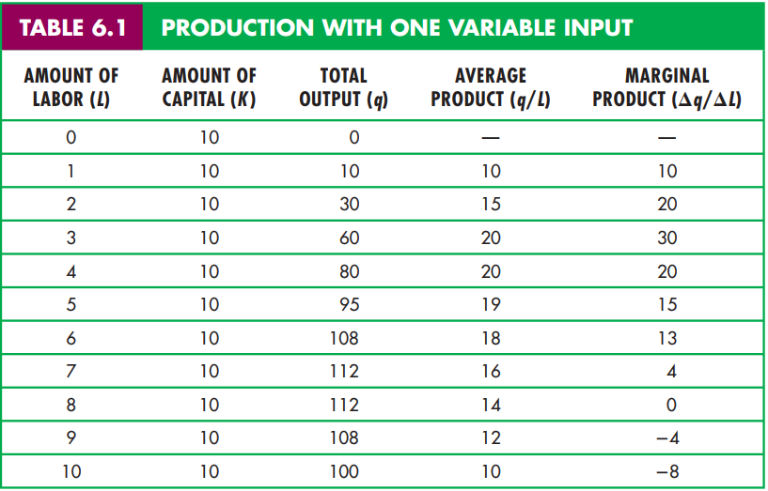

Slide 5
Slope of the product curve

Slide 6
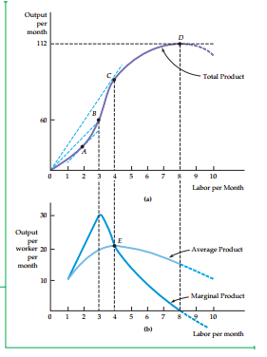

Slide 7
The Law of Diminishing Marginal Return
Applies to a given production technology

Slide 8
